Slide 1



Query-by-Sketch:Scaling Shortest Path Graph Queries on Very Large Networks
Ye Wang, Qing Wang, Henning Koehler, Yu Lin
^{SIGMOD 2021}
汇报人：何智鹏 指导老师：欧阳典

Slide 2
目录
研究背景
算法设计
实验结果
总结与展望

Slide 3
研究背景

Slide 4

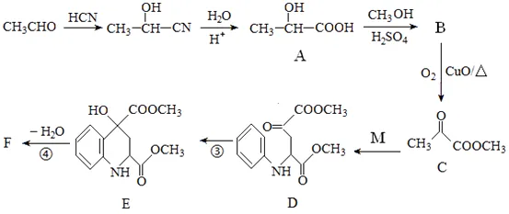
Graph
Notes:
https://www.researchgate.net/figure/The-defined-Performance-ased-Standards-PBS-road-network-in-Australia-showing-PBS_fig4_265404087
Road network is a weighted graph. The weight of road can present distance and travel time. It is usually an approximate planar graph

Slide 5
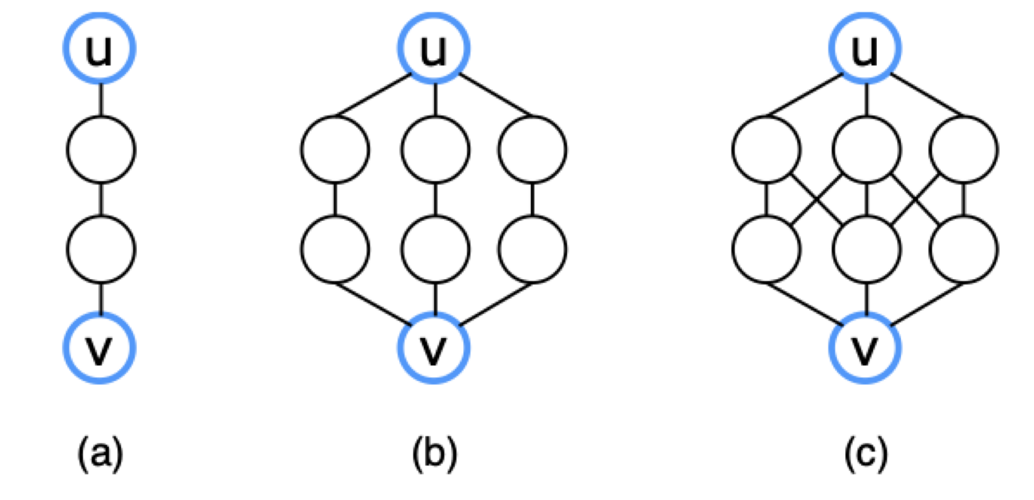
Introduction
Shortest path fundamental
找到两个顶点之间的最短路径
一条最短路径
三条最短路径
七条最短路径
Notes:
In accommodation-booking services such as Booking and Airbnb, a basic operation is to show several accommodations that are the closest to the location assigned by a user.
In restaurant-review services like Yelp, service providers need to present several restaurants near the user. In taxi-hailing services like Uber, several available vehicles near the pickup location are presented for users before they send the request.

Slide 6
Introduction
Shortest path fundamental
找到两个顶点之间的最短路径
距离相同
如果只考虑一条最短路径就无法将它们区分出来
一条最短路径
三条最短路径
七条最短路径
给一个图G，它包含顶点u，v
当考虑所有最短路径时，会表现出不同的结构
Notes:
In accommodation-booking services such as Booking and Airbnb, a basic operation is to show several accommodations that are the closest to the location assigned by a user.
In restaurant-review services like Yelp, service providers need to present several restaurants near the user. In taxi-hailing services like Uber, several available vehicles near the pickup location are presented for users before they send the request.

Slide 7
Introduction
Shortest path
找到两个顶点之间的最短路径
Shortest path graph
给定一个图G包含顶点u，v
寻找包含u和v之间的所有最短路径
Notes:
In accommodation-booking services such as Booking and Airbnb, a basic operation is to show several accommodations that are the closest to the location assigned by a user.
In restaurant-review services like Yelp, service providers need to present several restaurants near the user. In taxi-hailing services like Uber, several available vehicles near the pickup location are presented for users before they send the request.

Slide 8
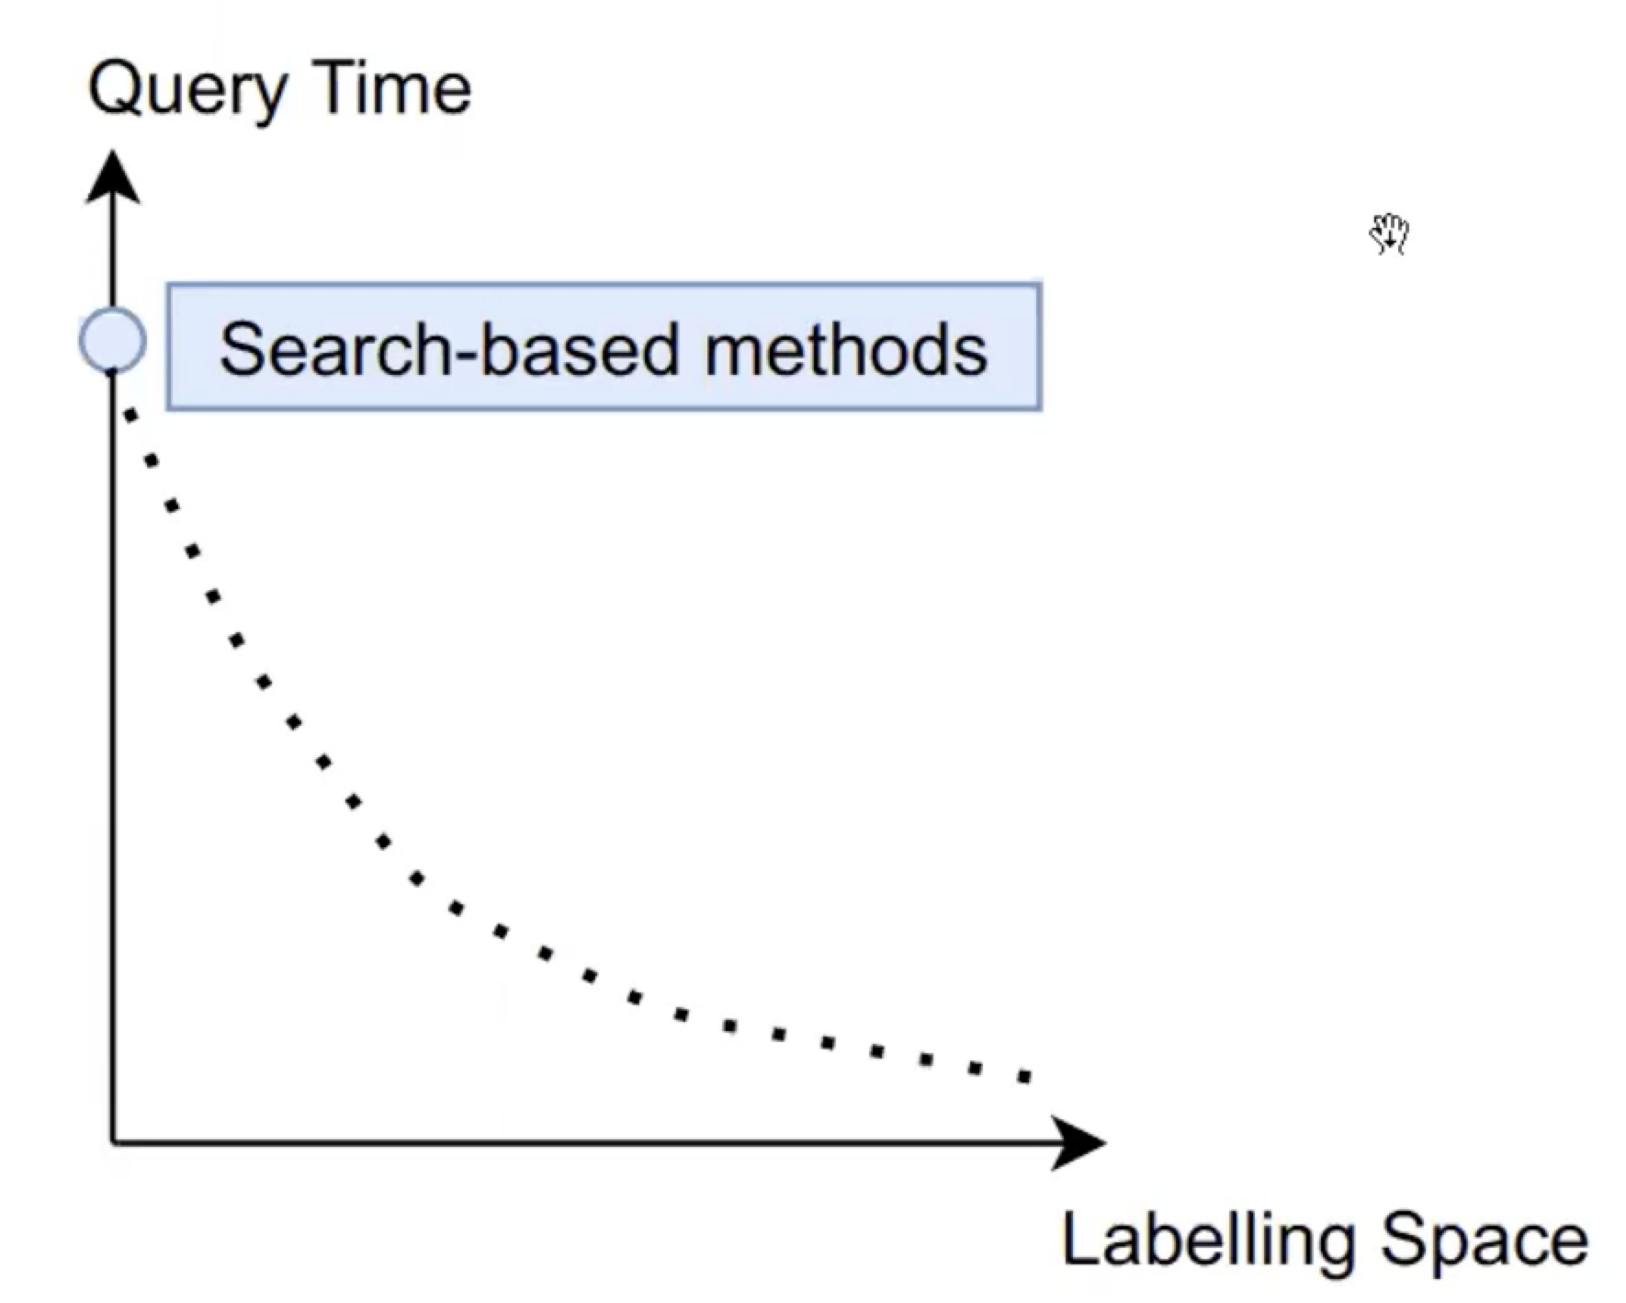
Related Work
基于搜索的方法
Dijkstra:O(|E|log|V|) query time
Breadth-first search：O(|E|) query time
Notes:
In accommodation-booking services such as Booking and Airbnb, a basic operation is to show several accommodations that are the closest to the location assigned by a user.
In restaurant-review services like Yelp, service providers need to present several restaurants near the user. In taxi-hailing services like Uber, several available vehicles near the pickup location are presented for users before they send the request.

Slide 9
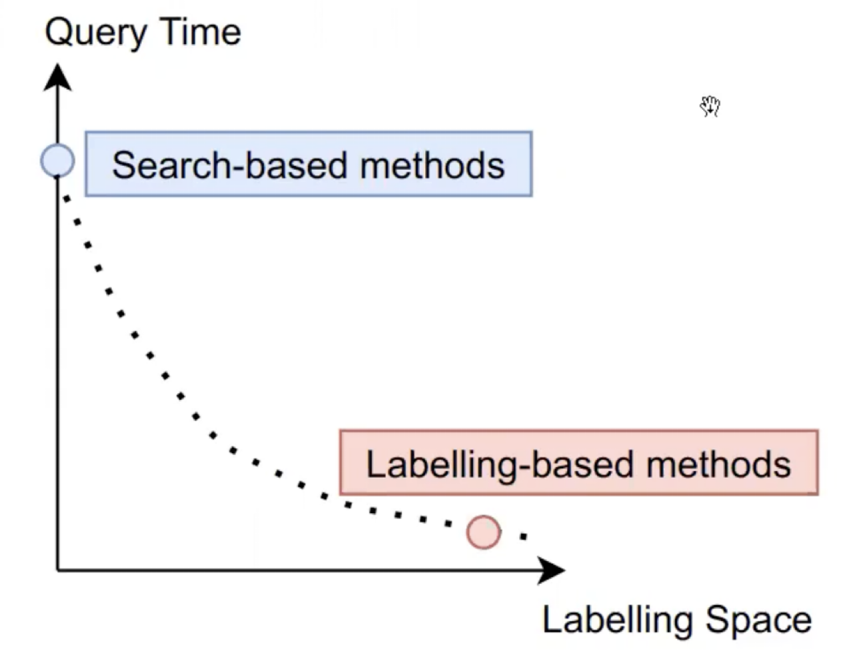
Related Work
基于搜索的方法
Dijkstra:O(|E|log|V|) query time
Breadth-first search：O(|E|) query time
基于标签的方法
Pruned path labeling: O(|V|^2) labeling space
Parent pruned path labeling: O(|V||E|) labeling space
Notes:
In accommodation-booking services such as Booking and Airbnb, a basic operation is to show several accommodations that are the closest to the location assigned by a user.
In restaurant-review services like Yelp, service providers need to present several restaurants near the user. In taxi-hailing services like Uber, several available vehicles near the pickup location are presented for users before they send the request.

Slide 10
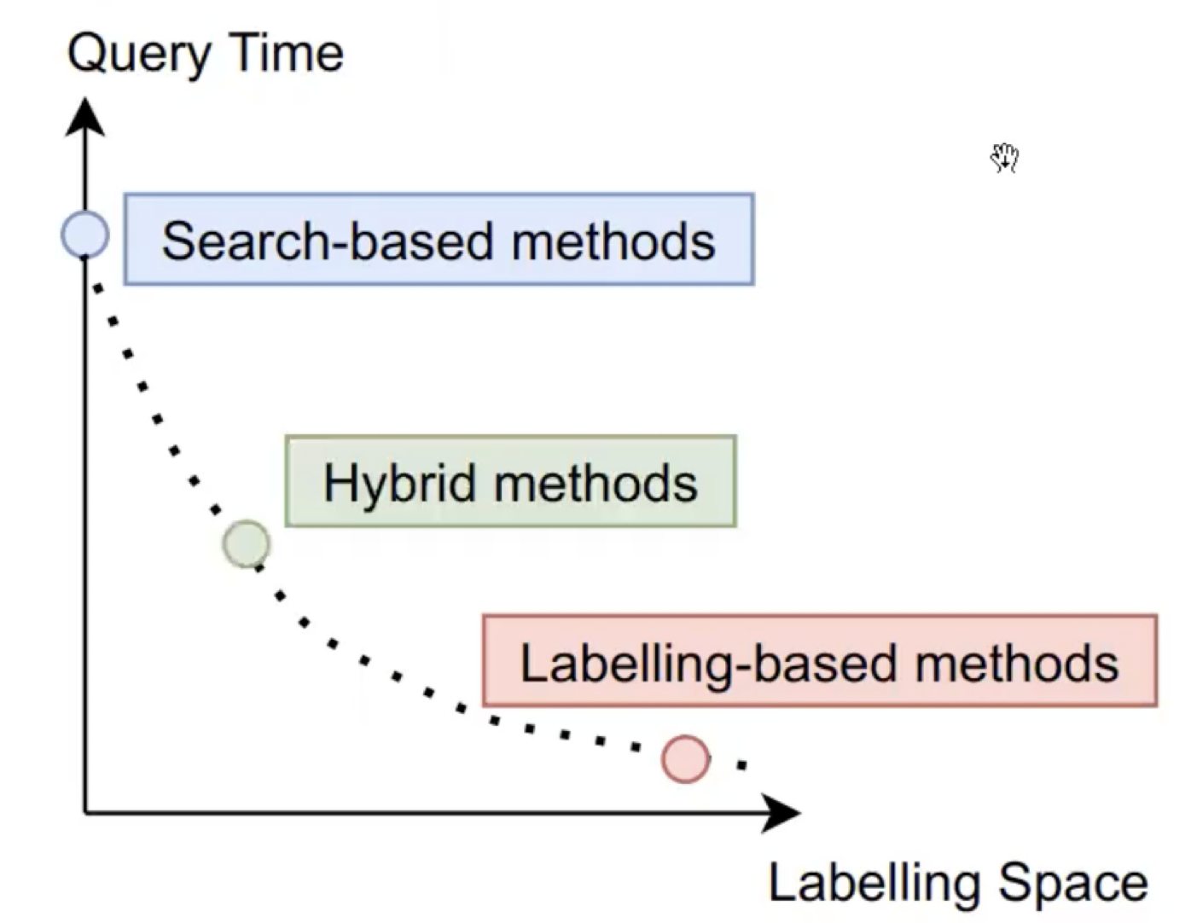
Related Work
基于搜索的方法
Dijkstra:O(|E|log|V|) query time
Breadth-first search：O(|E|) query time
基于标签的方法
Pruned path labeling: O(|V|^2) labeling space
Parent pruned path labeling: O(|V||E|) labeling space
混合方法？
查询时间和标记之间存在权衡
Notes:
In accommodation-booking services such as Booking and Airbnb, a basic operation is to show several accommodations that are the closest to the location assigned by a user.
In restaurant-review services like Yelp, service providers need to present several restaurants near the user. In taxi-hailing services like Uber, several available vehicles near the pickup location are presented for users before they send the request.

Slide 11
Query-by-Sketch（QbS）

Slide 12
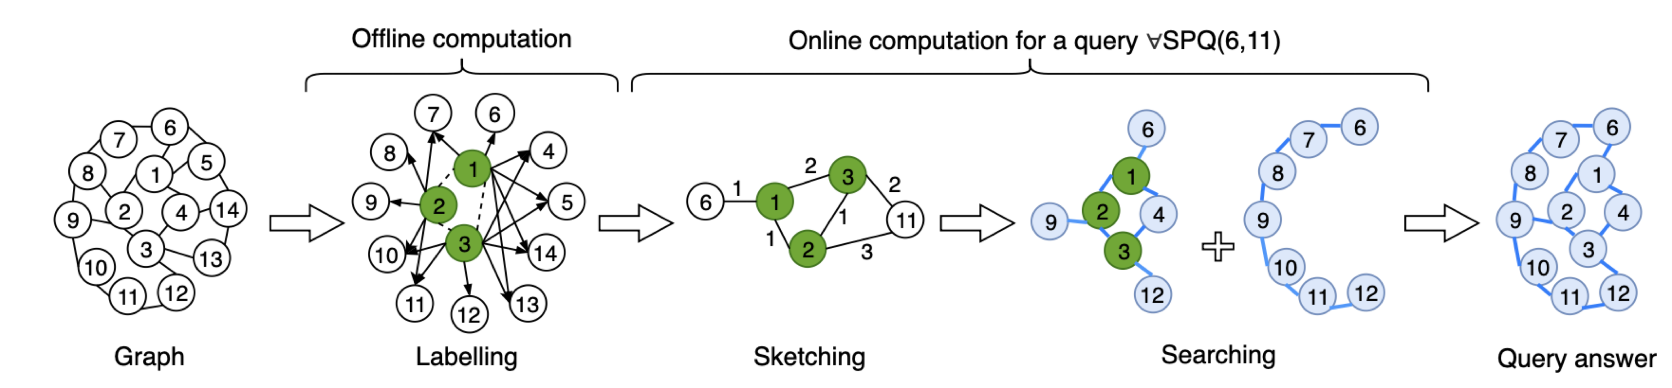
Query-by-sketch
Three key ideas：
（1）Labelling scheme-通过预计算，使用少量地标，构造一个紧凑且小尺寸的标签方案;
（2）Fast sketching-使用标签有效地计算总结了查询答案中最短路径的重要结构的sketch;
（3）Guided searching-在草图的“引导”下计算稀疏图上的最短路径。

Slide 13
Labelling Scheme
6
7
1
5
8
2
4
14
landmark
9
3
13
10
11
12
Graph
Meta-graph
Notes:
令G = (V, E) 是一个图，R ⊆ V 是一组地标，以及|R| << |V | （|R| 远小于 |V | ）。
作者首先对图 G 进行预处理，以获得地标之间最短路径的紧凑表示，称为 G 的元图。 然后，基于这样的元图，作者定义了一个标签方案，为G中的每个顶点分配一个标签，这样，给定任何一对顶点u，v ∈ V，我们可以有效地计算一个草图来回答SPG(u，v),，即最短路径图查询。

Slide 14
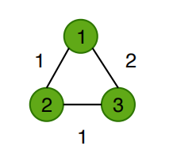
Labelling Scheme
6
7
1
5
8
2
4
14
9
3
13
10
11
12
Meta-graph
Graph
去除最大度数顶点比去除低度数顶点更能稀疏化一个图；
计算从两个顶点到大度数landmark的距离可以很好地估计这两个顶点之间的最短距离
Notes:
令G = (V, E) 是一个图，R ⊆ V 是一组地标，以及|R| << |V | （|R| 远小于 |V | ）。
作者首先对图 G 进行预处理，以获得地标之间最短路径的紧凑表示，称为 G 的元图。 然后，基于这样的元图，作者定义了一个标签方案，为G中的每个顶点分配一个标签，这样，给定任何一对顶点u，v ∈ V，我们可以有效地计算一个草图来回答SPG(u，v),，即最短路径图查询。

Slide 15
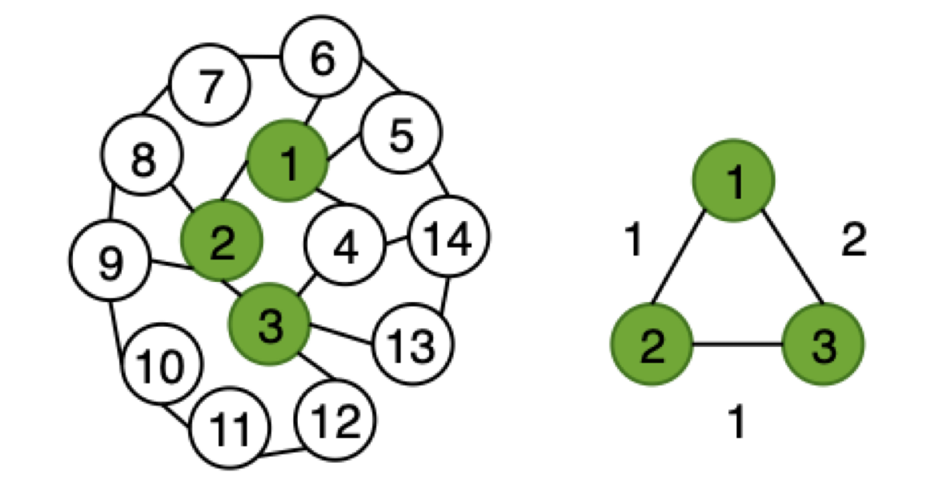
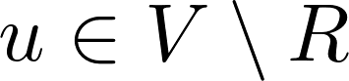
Labelling Scheme
Label | Labelling Entries
L (4)
L(5)
L(6)
L(7)
L(8)
L(9)
L(10)
L(11)
L(12)
L(13)
L(14)
(1,1)
(3,1)
(1,1) (3,3)
(1,1)
(1,2) (2,2)
(2,1)
(2,1)
(2,2) (3,3)
(2,3) (3,2)
⚠️注意：
地标不用做标签
顶点到一个地标的路径不能通过其他的地标
(3,1)
(1,3) (3,1)
(1,2) (3,2)
标签方案=(M,L)由元图M和路径标签L组成，该标签为每个顶点 分配一个L(u) 标签。为了准确表示顶点如何与地标相关联，我们只允许(𝑟, 𝛿𝑢𝑟 ) 在标签L(u)中，当且仅当在u和r之间至少存在一条不包含其他地标的最短路径。L(u)表示如下：

Slide 16
Labelling Scheme
BFS rooted at the landmark 1
6
7
5
8
1
2
4
14
9
3
13
10
11
12
Graph

Slide 17
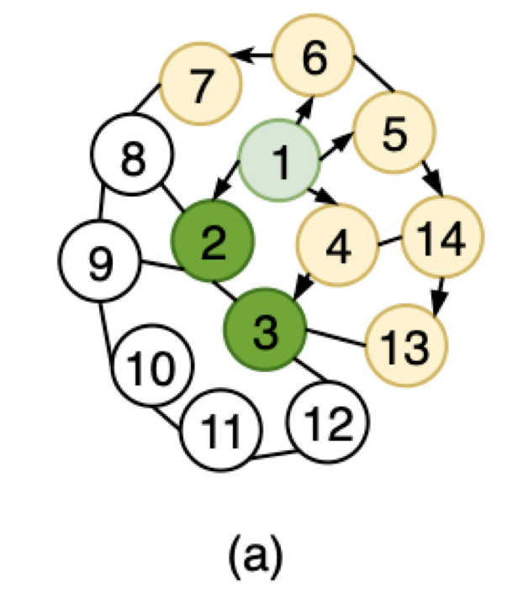
Labelling Scheme
BFS rooted at the landmark 1
6
7
5
8
1
1
2
4
14
9
1
3
13
2
10
11
12
Graph

Slide 18
Labelling Scheme
BFS rooted at the landmark 1
6
7
5
8
1
1
2
4
14
9
1
3
13
2
10
11
12
Graph

Slide 19
Labelling Scheme
BFS rooted at the landmark 1
6
7
5
8
1
1
2
4
14
2
9
1
3
13
2
3
10
1
11
12
Graph
Meta-Graph

Slide 20
Labelling Scheme
BFS rooted at the landmark 1
6
7
5
8
1
1
2
4
14
2
9
1
3
13
2
3
10
1
11
12
Graph
Meta-Graph

Slide 21
Labelling Scheme
BFS rooted at the landmark 1
6
7
5
8
1
1
2
4
14
2
9
1
3
13
2
3
10
1
11
12
Graph
Meta-Graph

Slide 22
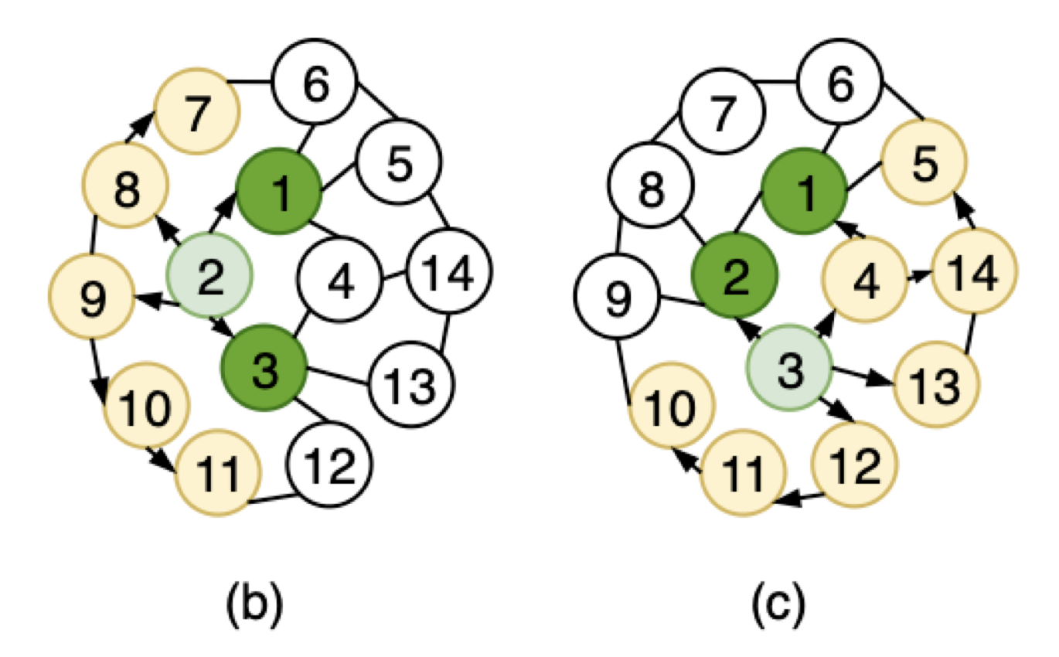
Labelling Scheme

Slide 23
Fast Sketching
求出两个顶点6和11的最短路径图。
6
7
1
5
8
2
4
14
9
3
13
10
11
12
Graph

Slide 24
Query-by-sketch
Three key ideas：
（1）Labelling scheme-通过预计算，使用少量地标，构造一个紧凑且小尺寸的标签方案;
（2）Fast sketching-使用标签有效地计算总结了查询答案中最短路径的重要结构的sketch;
（3）Guided searching-在草图的“引导”下计算稀疏图上的最短路径。

Slide 25
Fast Sketching
求出两个顶点6和11的最短路径图。
6
7
2
3
2
1
5
1
8
1
11
6
1
2
4
14
9
1
3
3
13
2
10
11
12
Sketch
Graph

Slide 26
Query-by-sketch
Three key ideas：
（1）Labelling scheme-通过预计算，使用少量地标，构造一个紧凑且小尺寸的标签方案;
（2）Fast sketching-使用标签有效地计算总结了查询答案中最短路径的重要结构的sketch;
（3）Guided searching-在草图的“引导”下计算稀疏图上的最短路径。

Slide 27
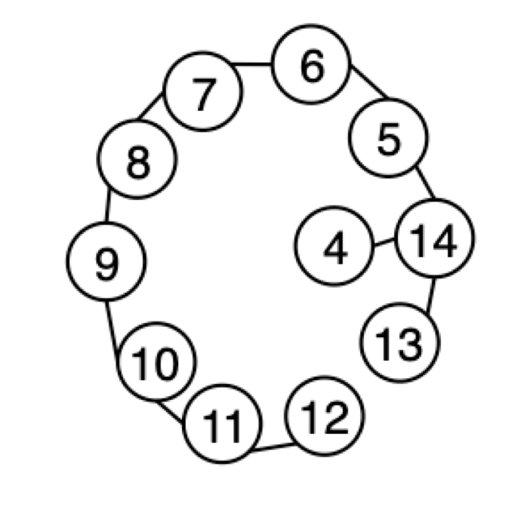
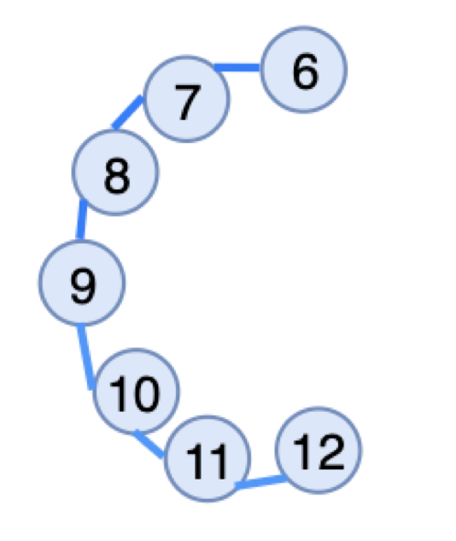

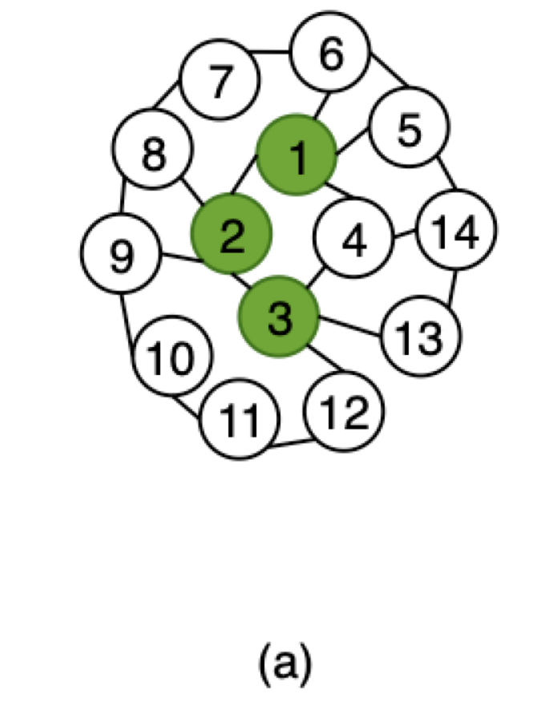

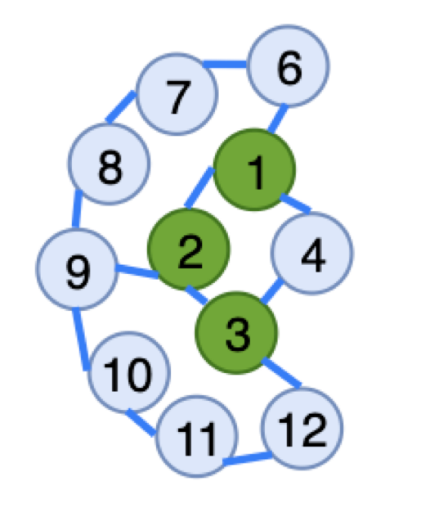
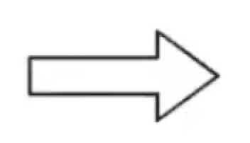
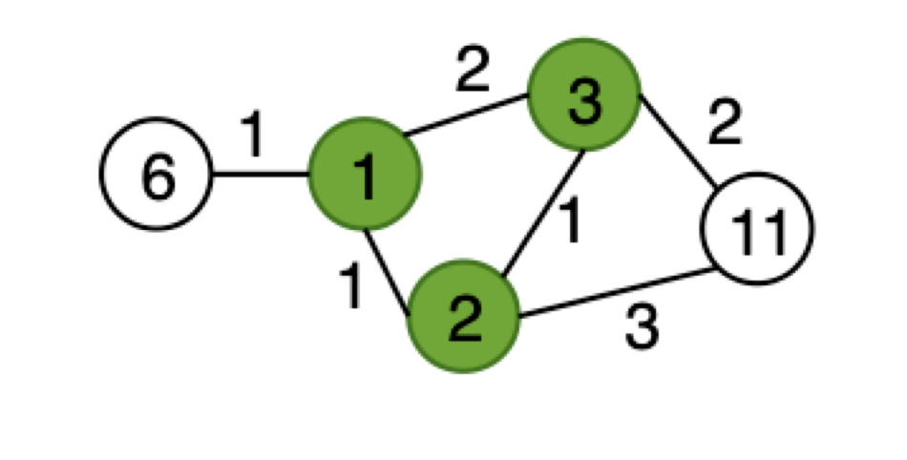
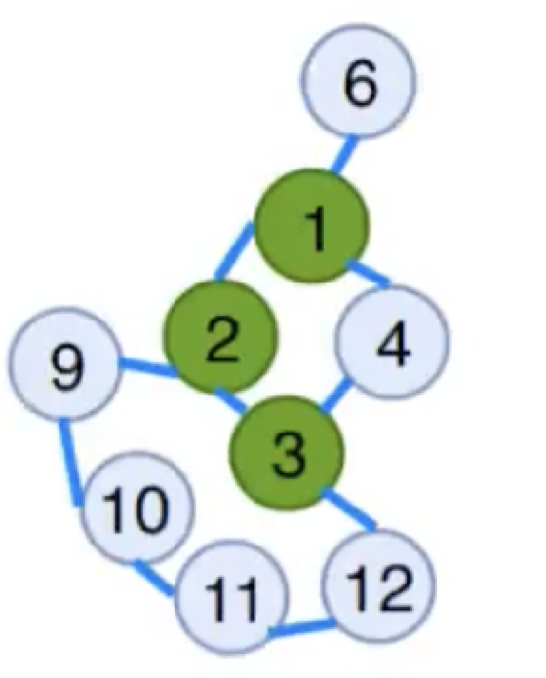
Guided Searching
从 G 中删除 所有地标以及与这些地标相关的所有边
搜索草图捕获的最短路径

Slide 28
实验结果

Slide 29
Experiment
作者根据基线评估草图查询（QbS）：
基于搜索的方法:
Bi-directional BFS(Bi-BFS)
基于标签的方法:
Pruned path labelling (PPL)
Parent pruned path labelling (ParentPPL)

Slide 30
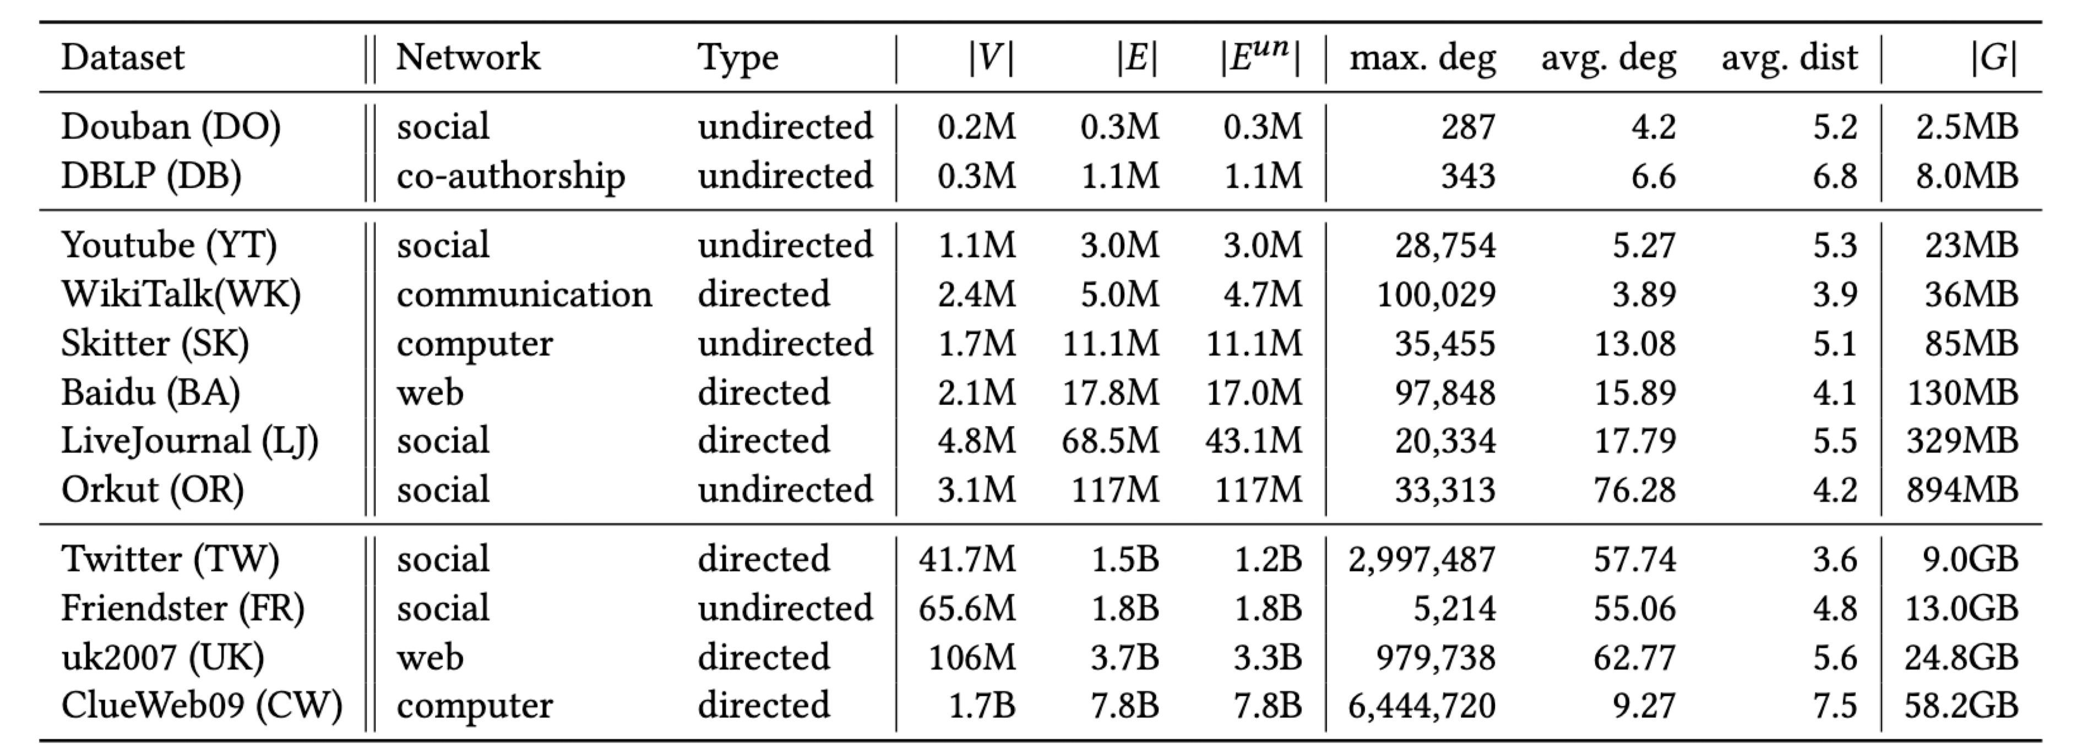
Experiment
数据集：12个真实世界中的复杂网络

Slide 31
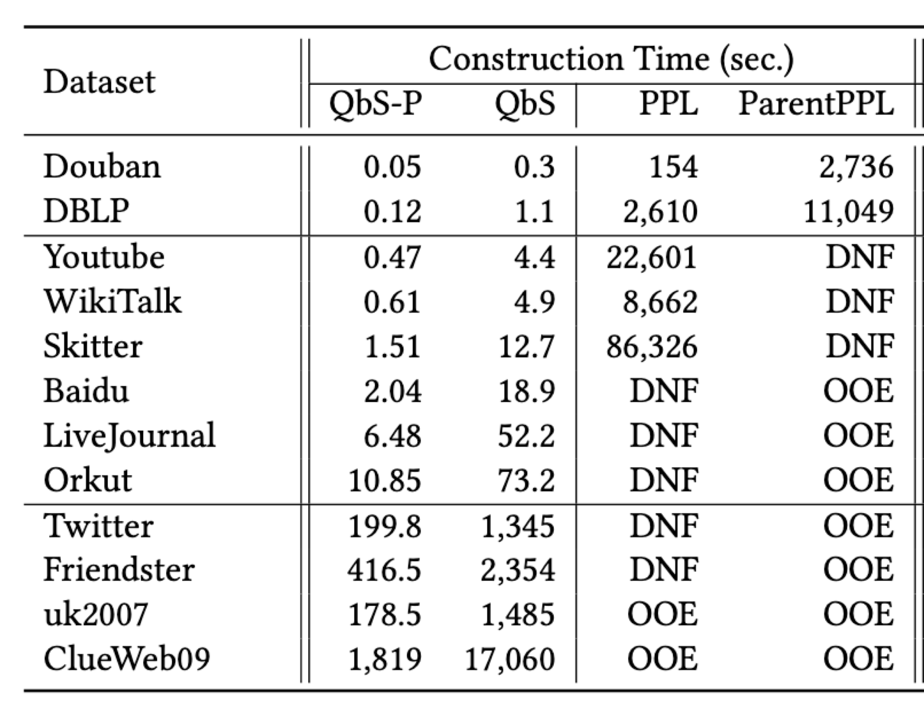
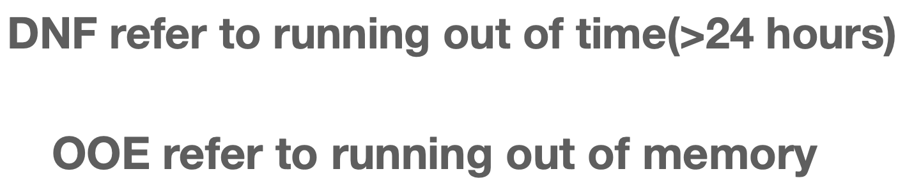
Experiment
Q1: QbS构建标签的效率如何？

Slide 32
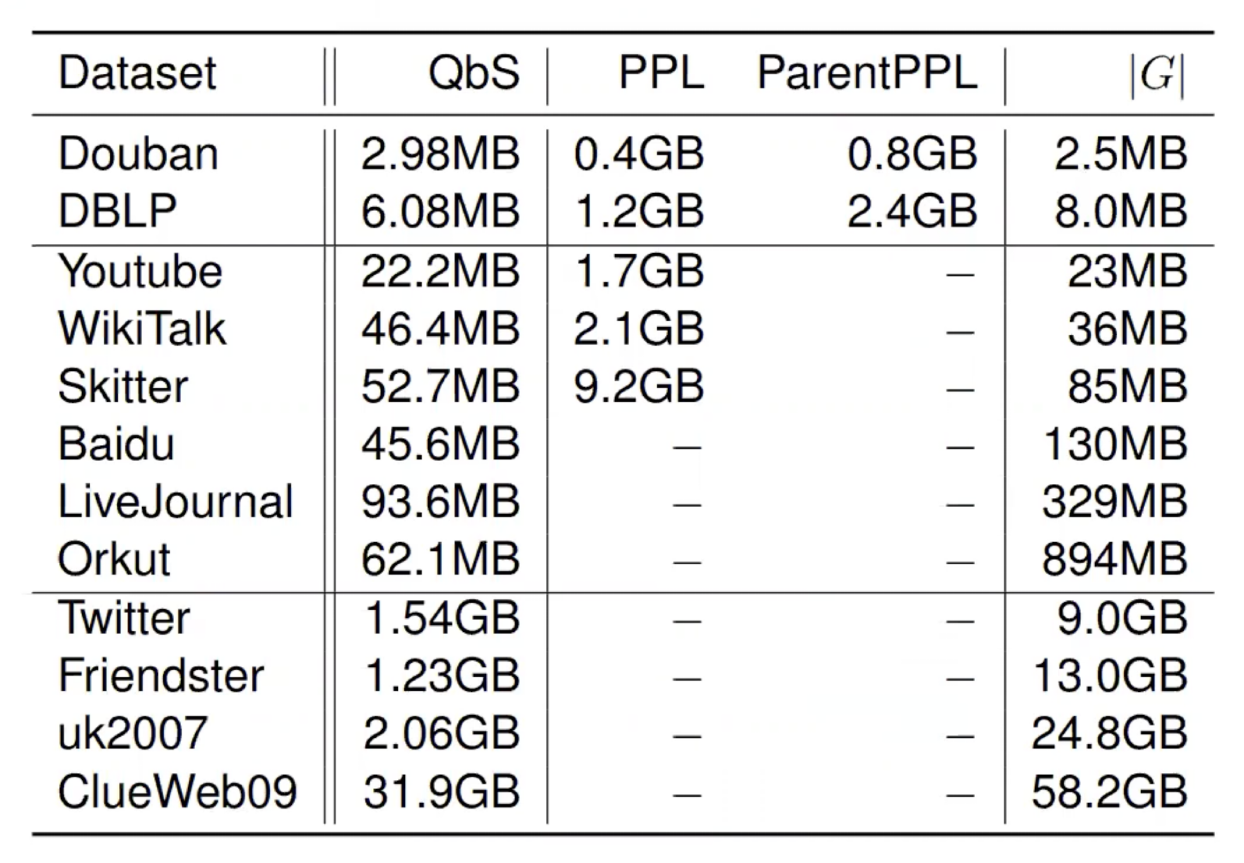
Experiment
Q2: QbS在标签大小方面的表现如何？

Slide 33
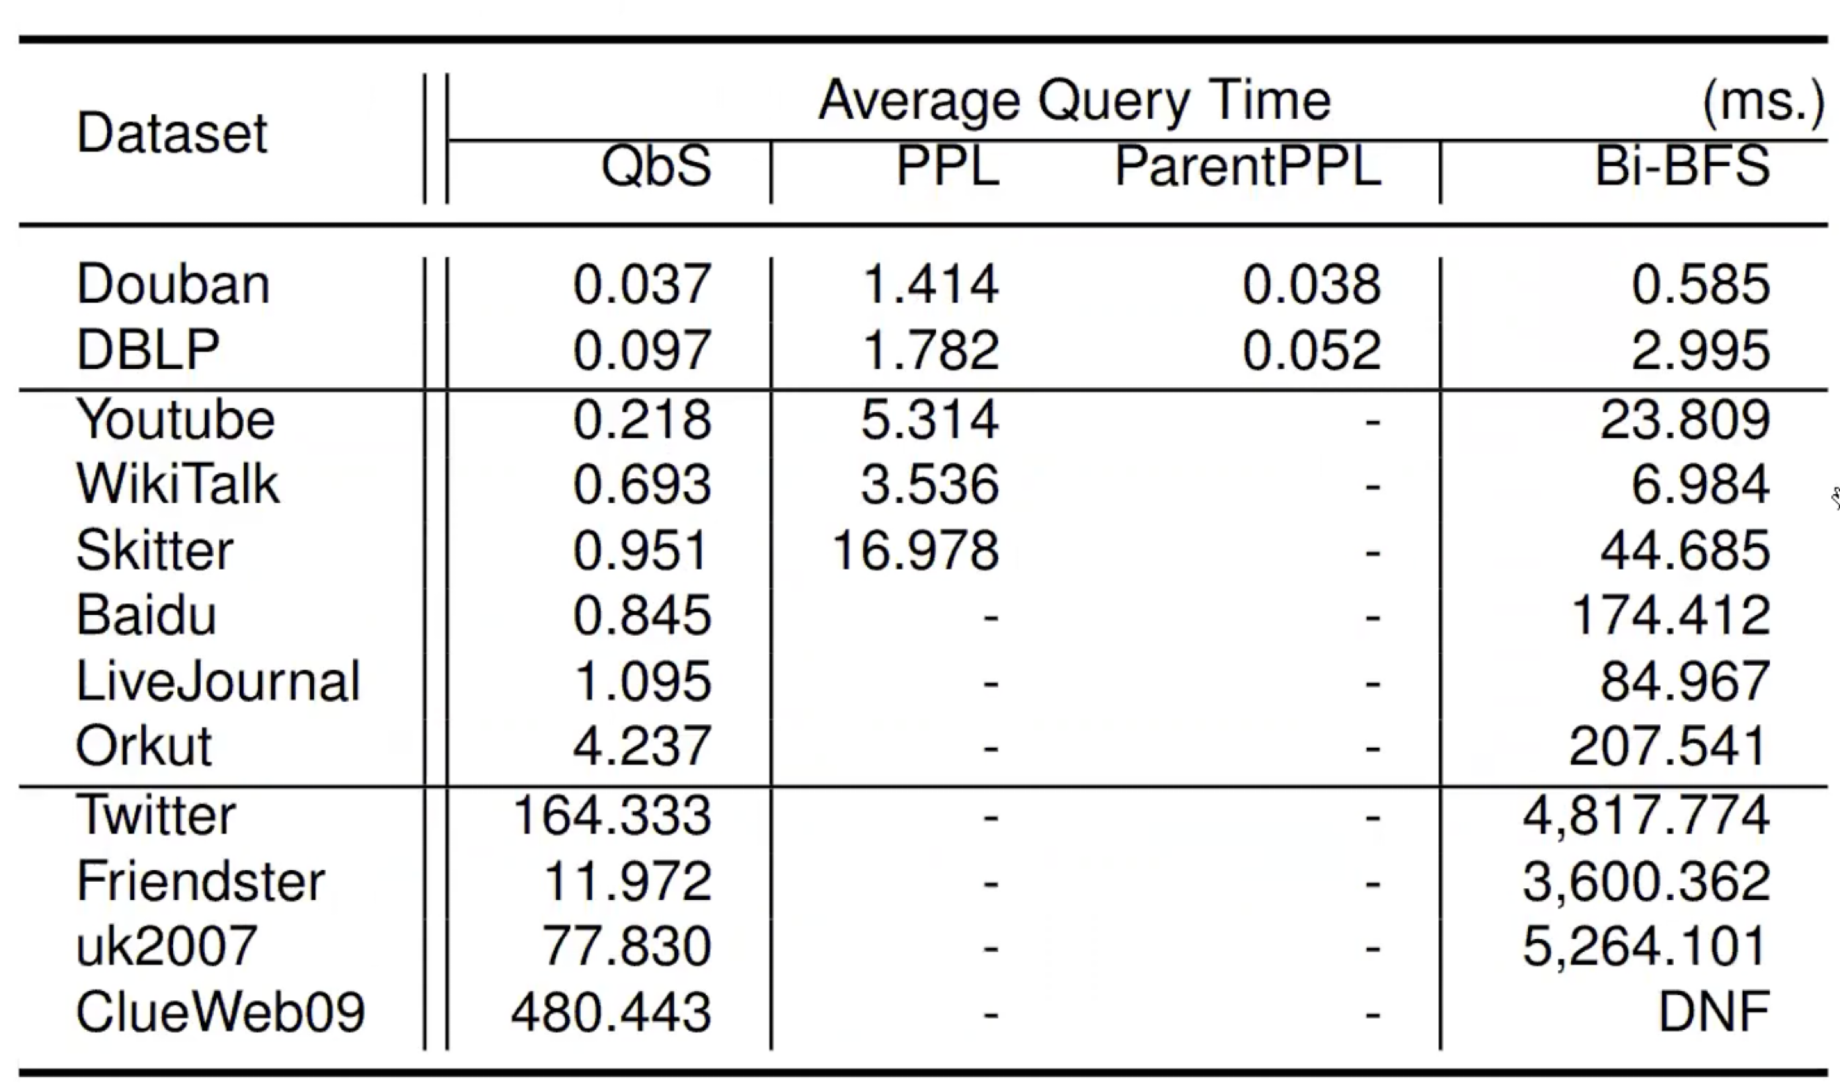
Experiment
Q3: QbS在查询时间方面的表现如何？

Slide 34
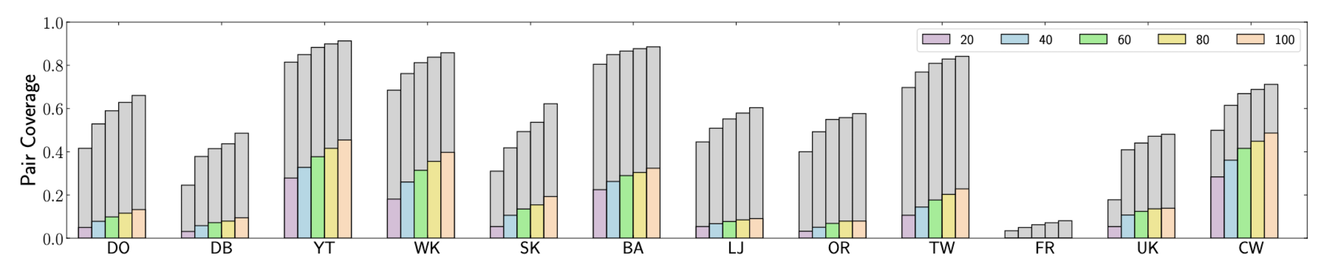
Experiment
Q4: “草图”在多大程度上有助于提高性能？

Slide 35
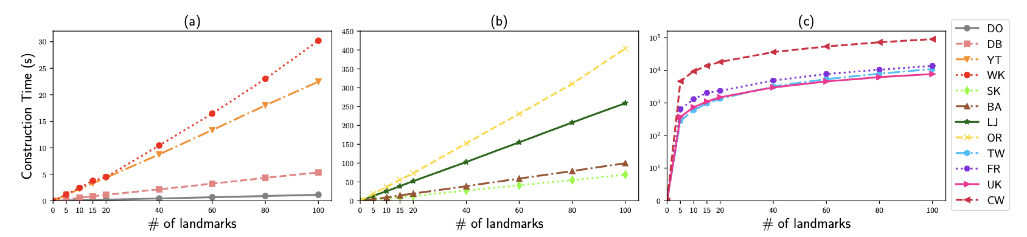
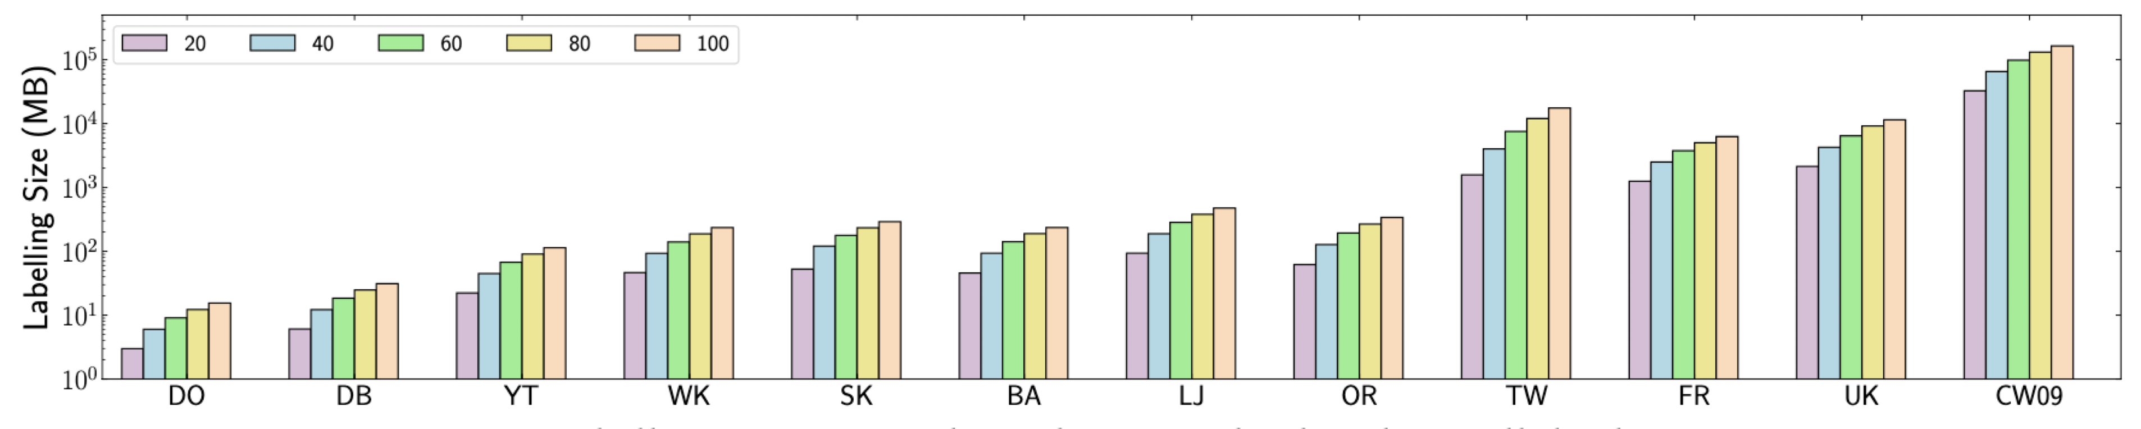
Experiment
Q5: 地标的数量如何影响性能？

Slide 36
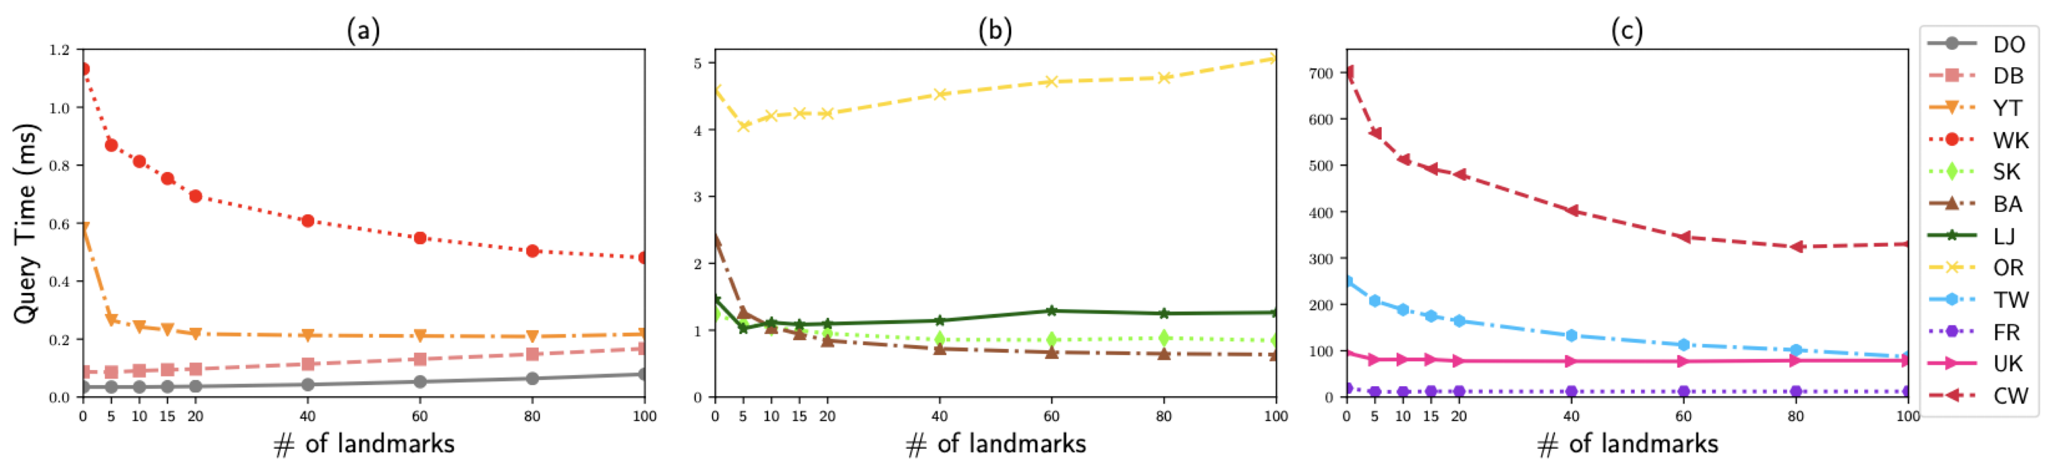
Experiment
Q5: 地标的数量如何影响性能？

Slide 37
总结

Slide 38
Summary
（1）构建标记方案-通过预计算，使用少量地标，构造一个紧凑且小尺寸的标签方案;
（2）计算草图-使用标签有效地计算总结了查询答案中最短路径的重要结构的sketch;
（3）执行引导搜索-在草图的“引导”下计算稀疏图上的最短路径。
QbS提高效率的来源：
具有高中心性的部分被稀疏化。尽管仅仅去除少量的地标并不能显著减少整个图中的边的数量，但查询所遍历的边的数量却显著减少。
使用草图来指导每个查询的搜索，进一步减少了被遍历的边的数量
当两个或多个地标出现在一条最短路径上时，QbS可以避免计算高度数地标之间的最短路径，因为这些最短路径可以预先计算。
优势：
它可以在大型网络上扩展
百万条边的数据集的标注构建需要10秒，最大的数据集ClueWeb09的标注构建需要半小时
对于具有数十亿条边的图，回答查询只需要大约 0.01 - 0.5 秒

Slide 39
Summary
QbS提高效率的来源：
具有高中心性的部分被稀疏化。尽管仅仅去除少量的地标并不能显著减少整个图中的边的数量，但查询所遍历的边的数量却显著减少。
使用草图来指导每个查询的搜索，进一步减少了被遍历的边的数量
当两个或多个地标出现在一条最短路径上时，QbS可以避免计算高度数地标之间的最短路径，因为这些最短路径可以预先计算。
优势：
它可以在大型网络上扩展
百万条边的数据集的标注构建需要10秒，最大的数据集ClueWeb09的标注构建需要半小时
对于具有数十亿条边的图，回答查询只需要大约 0.01 - 0.5 秒
展望：研究地标选择策略来提高性能

Slide 40
Thank you!

